Slide 1


Project Group – Kick Off
3D Environment Based Intelligent Systems Engineering of Advanced Systems (B.A.T.M.A.N.)
M.Sc. Sergej Japs, M.Sc. Aschot Kharatyan
Notes:
Hello Sergej Japs, I‘m research associate at Fraunhofer in Paderborn. An I will present you the Project Group BATMAN.

Slide 2

Kick-Off
Agenda
Introduction of supervisors
Short recap: Introduction of the project group B.A.T.M.A.N.
Introduction of project group participants
Project group organization
Introduction of project group topics
Next steps

Slide 3
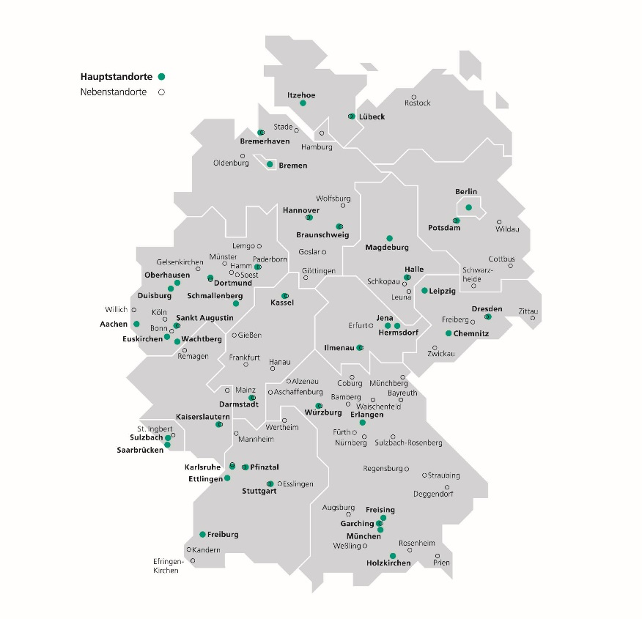
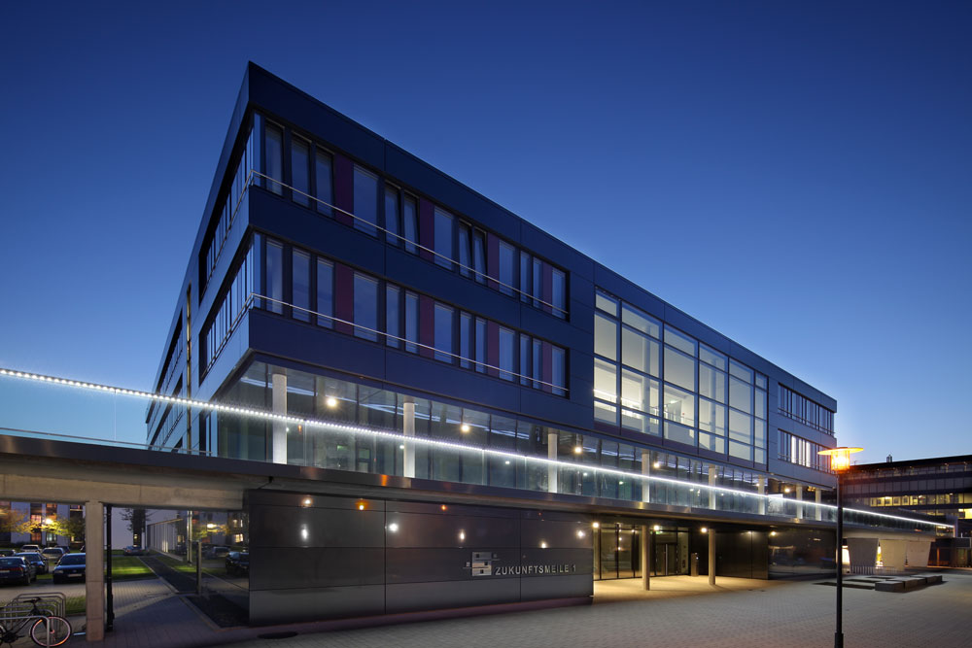


Overview of the Fraunhofer Society
Application-oriented research for the immediate benefit of the economy and society
26 600 Employees
Fraunhofer Institut für Entwurfstechnik Mechatronik IEM Paderborn
Prof. Trächtler, Prof. Dumitrescu, Prof. Bodden
Distinct orientation towards midsize companies
> 110 Employees
76 Institutes and research facilities
Notes:
The fraunhofer society is doing applied research.
We have 26000 employees in germany
And 76 Institutes in germany
The paderborn institute has over 110 employees
We have three reasarch areas, and all of these areas are directed by Professors of the university of paderborn
Our project group belongs to product development, directed by Prof. Dumitrescu.

Slide 4

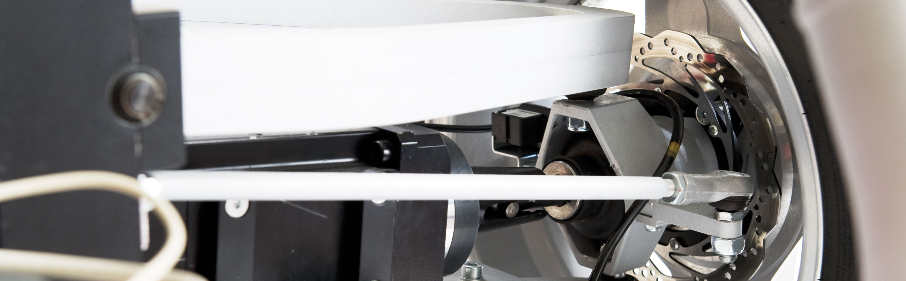
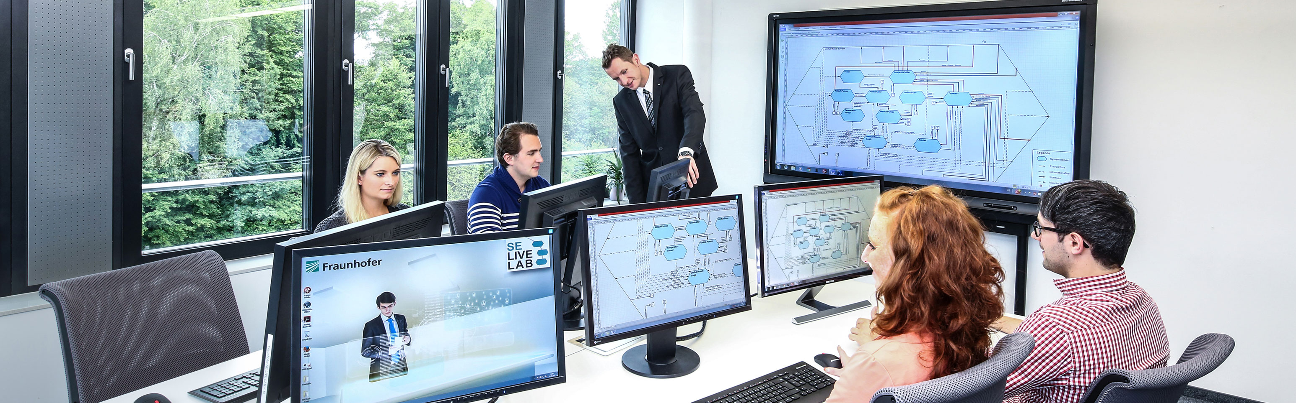
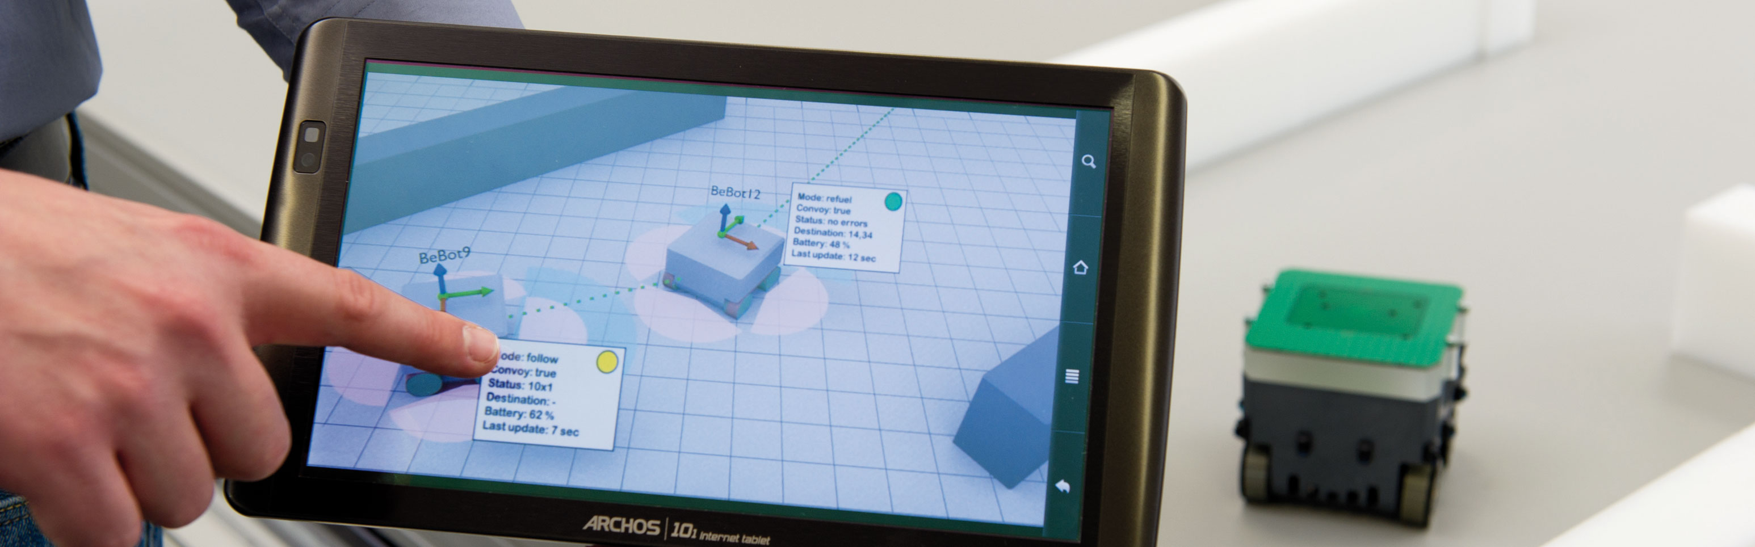


















Fraunhofer IEM Fields of expertise
Notes:
We have expertise in different from the marked demanded fields.
And we adress big complanies like Audi, BMW or Miele, but also smaller companies

Slide 5

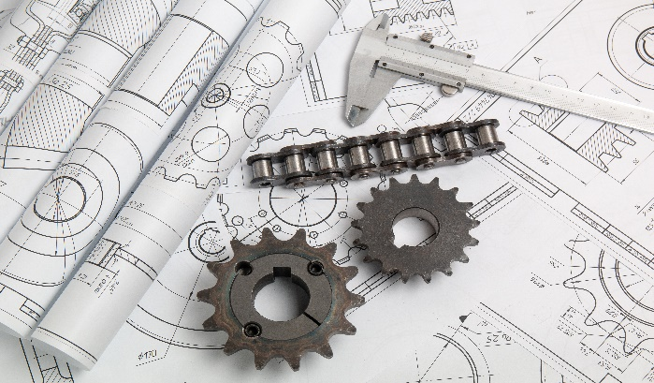
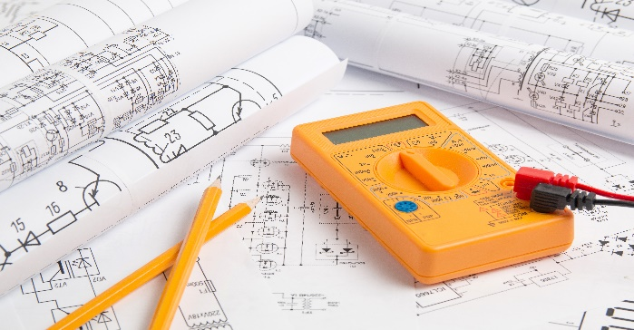

Different stakeholder – Different approaches
Notes:
So we have different stakeholder like mechanical engineers, electrical engineers and software developer.
Every stakeholder has it‘s own view on the to be designed system.
In order to work them all together, we need suited approaches and tools.

Slide 6



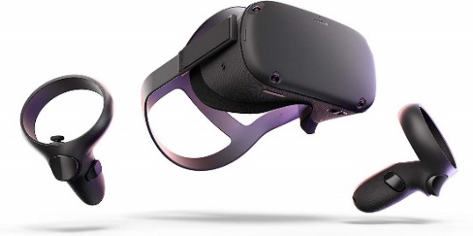


Vision Advanced Digital Engineering
How can creativity and communication be supported by the use new technologies?
How can the user be supported by the automated deduction of further relevant models by an artificial intelligence?
How can unstructured knowledge about threats and vulnerabilities from news, blogs, etc. be integrated automatically?
Source: Occulus VR
Source: Microsoft
Notes:
We analyzed the existing approaches.
A lot of them were not digital assisted.
And the digital assisted approaches were some kind of outdated or to specific for CPS.
We asked us:
How can creativity an communication be supported by the use of new technologies?
How can AI be used to enhance the engineering?
And how can unstructed knowledge be used to identify threats?

Slide 7
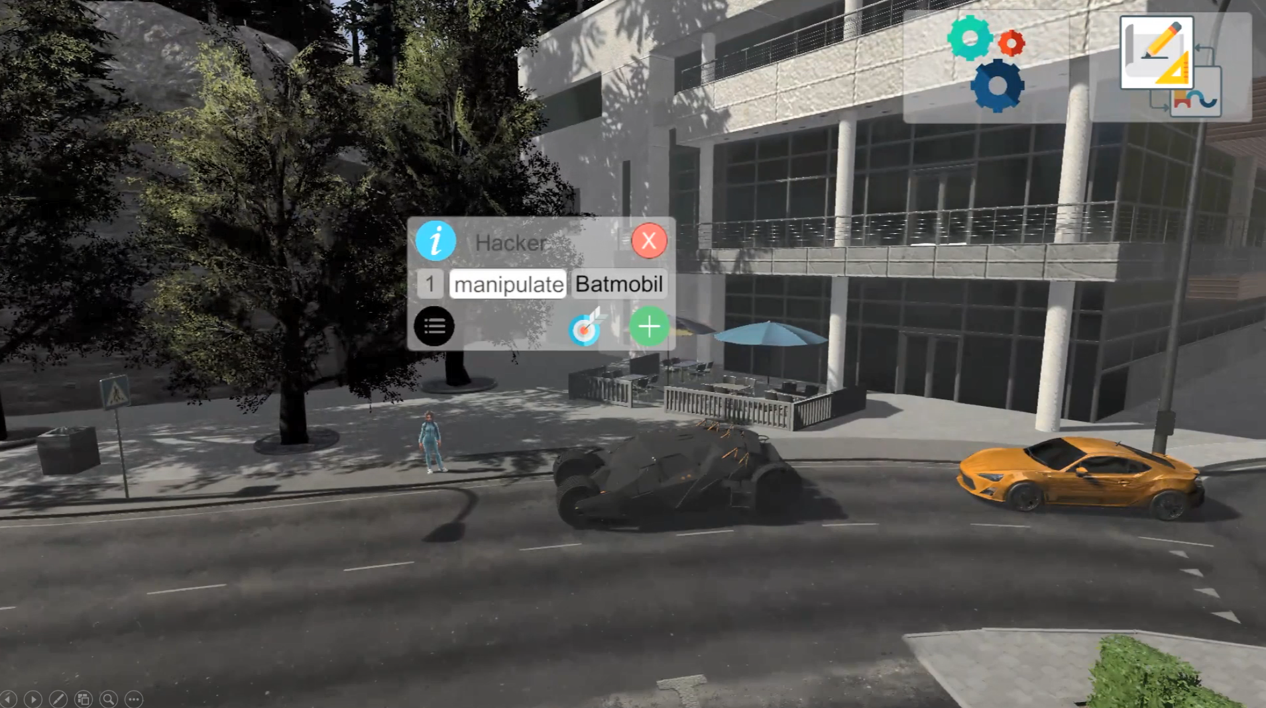
Advanced Digital Engineering First Results
Japs et. al., Method for 3D-Environment Driven System Design and Automatic Derivation of a System Model, DESIGN 2020
Batmobile: https://sketchfab.com/sam146
Notes:
We developed a tool in Unity, which works on different touch devices.
The tool can be used in workshops with different stakeholders to get a visual feeling of the to be designed system and it‘s interacting environment.
For that we use the unity asset store which has more than 30000 3D-Models.
You can play arround with the 3D objects and create relationships between them.

Slide 8
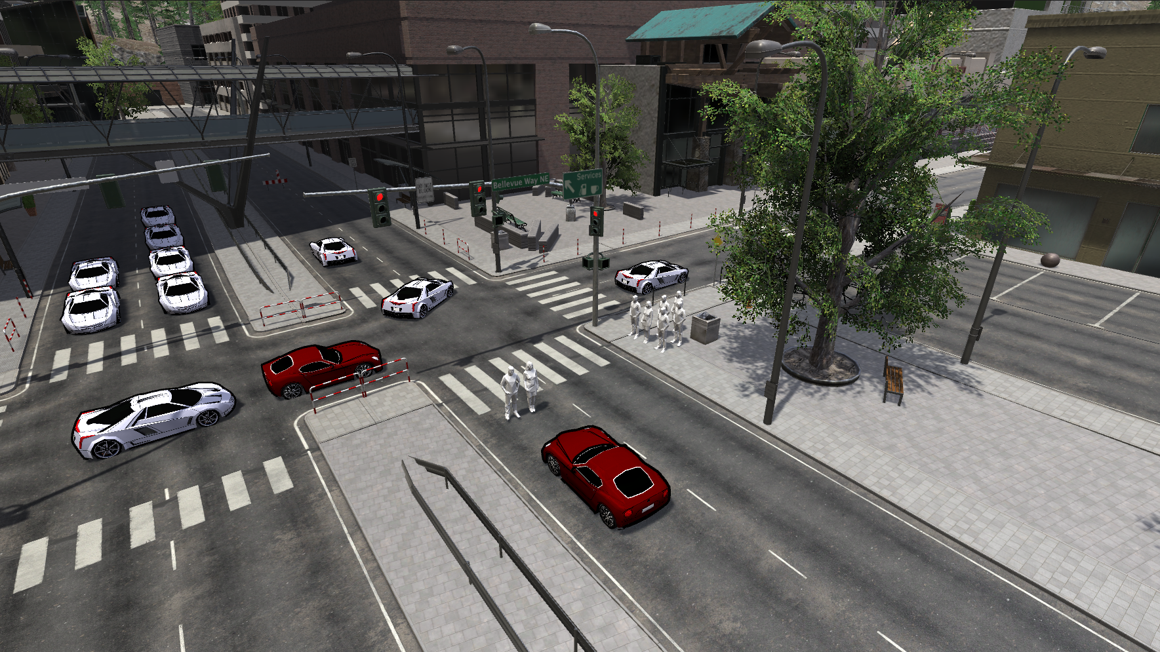
Advanced Digital Engineering First Results
Traffic Light
Emergency communication
Pedestrians
Other cars
Automatic braking
Autonomous car
Street
Street guards
Slip regulation
Pedestrians: https://sketchfab.com/norgeotloic
Notes:
Then you click on a button and a UML model for systems will be automatically created.
So you just play arround in the 3D environment, but you will have serious results.

Slide 9

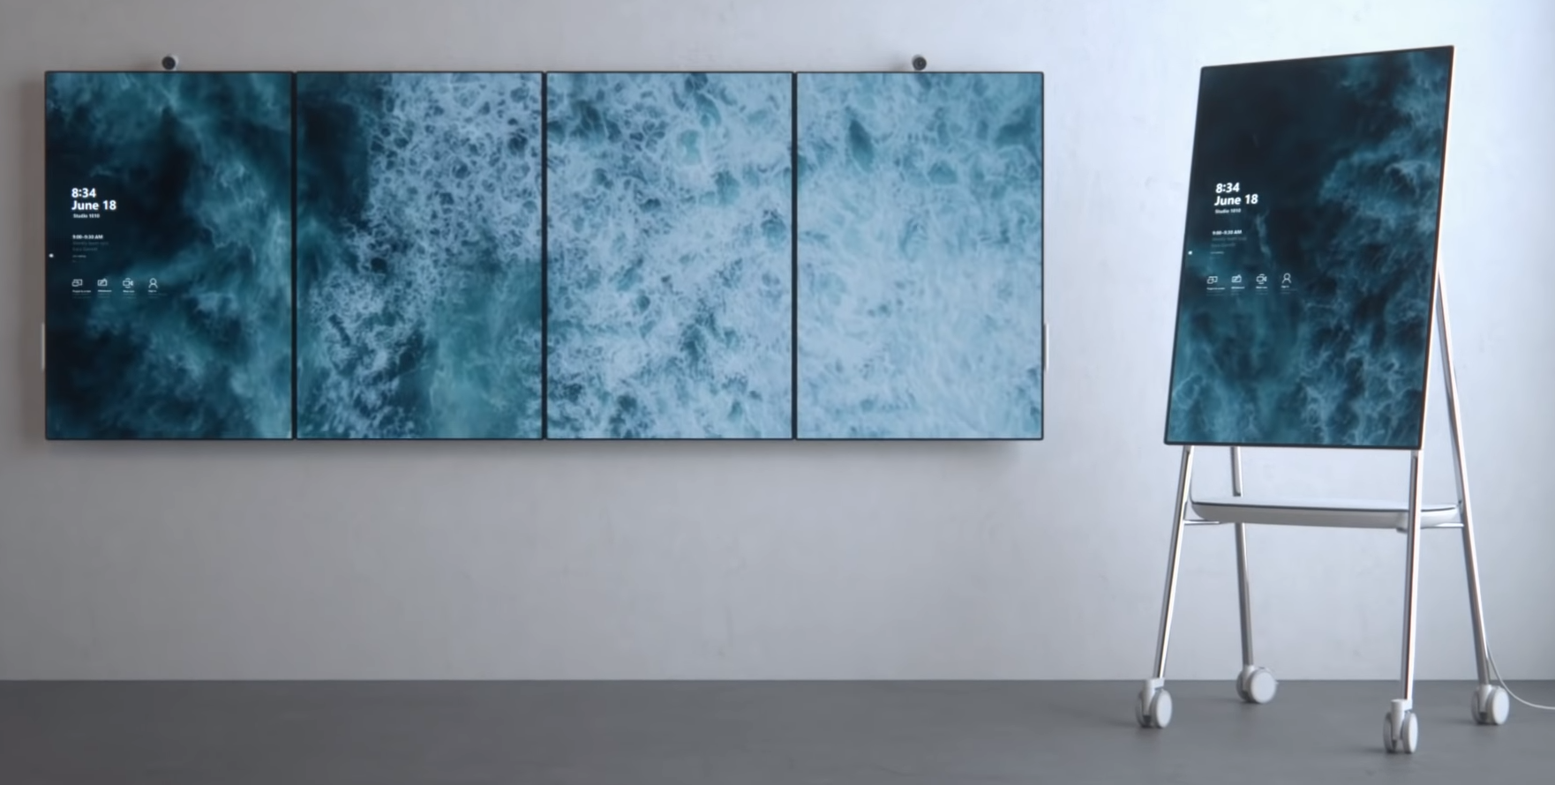
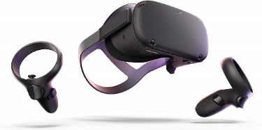
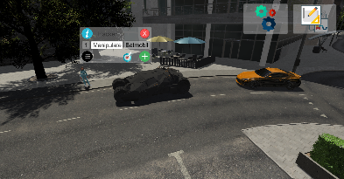
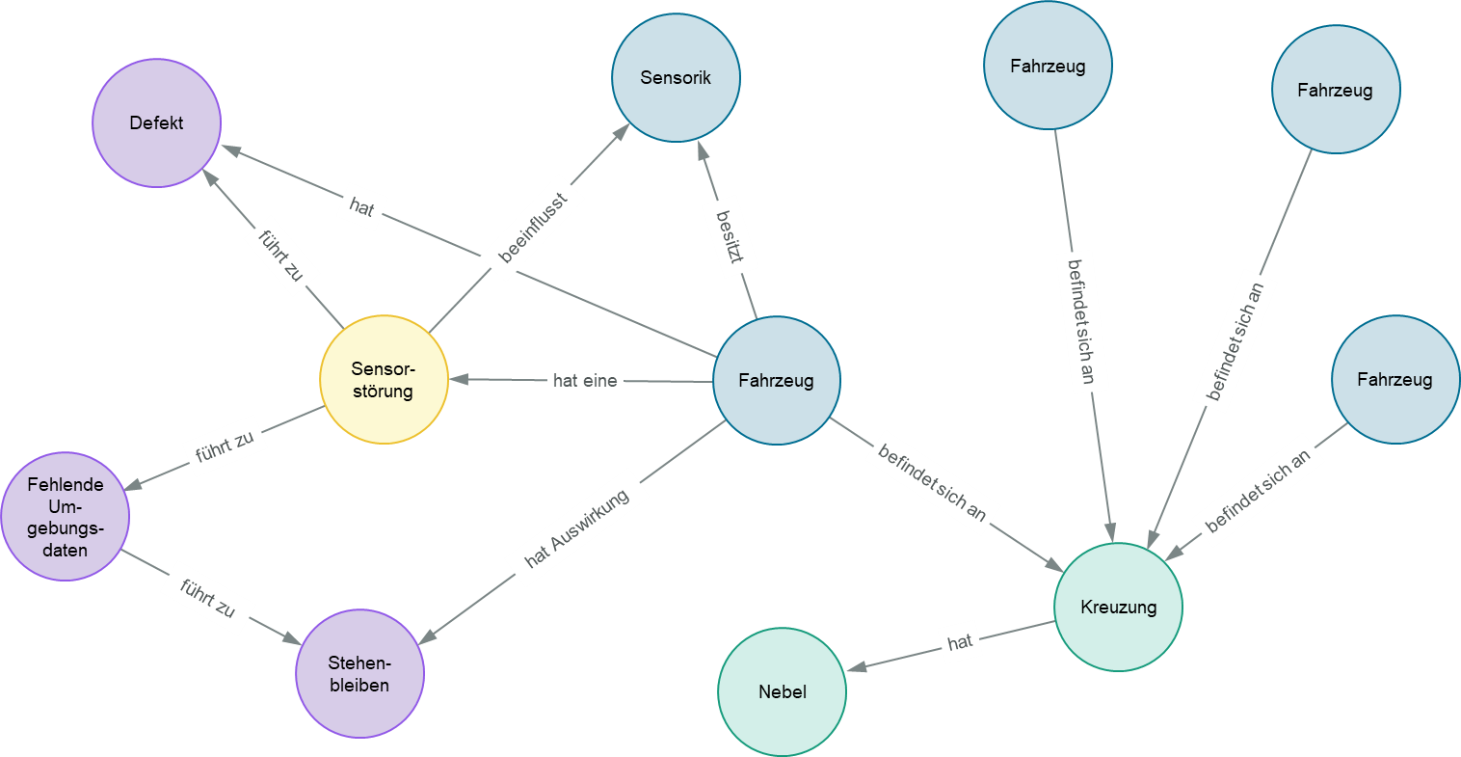
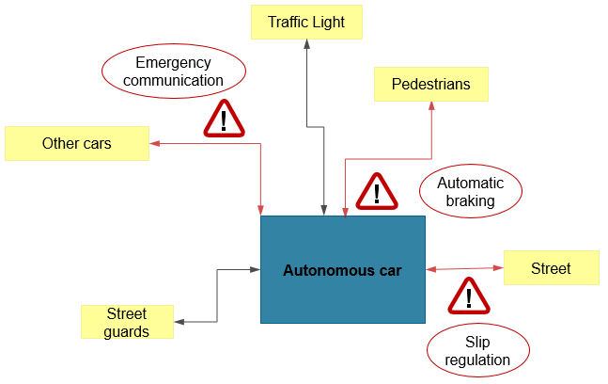
Project Group B.A.T.M.A.N. Goals
Virtual Reality - Improvement of the engineering experience through virtual reality
Networking - Enabling collaborative engineering with simultaneous use of multiple devices
Artificial Intelligence - Improvement of engineering efficiency through the usage of AI
Augmented Reality/3D Printing - Improvement of the engineering experience through physical 3D models
Level Design - Design of different scenarios related to autonomous driving
Source: Microsoft
Source: Occulus VR
Source: Microsoft
Notes:
We want 7 seven of you, to extend our vision.
The goals of the project group are:

Slide 10
Kick-Off Introduction of participants
Short introduction from all project group participants
Who are you?
What have you done before?
In which topics are you interested in?
What do you want to learn in the project group?

Slide 11
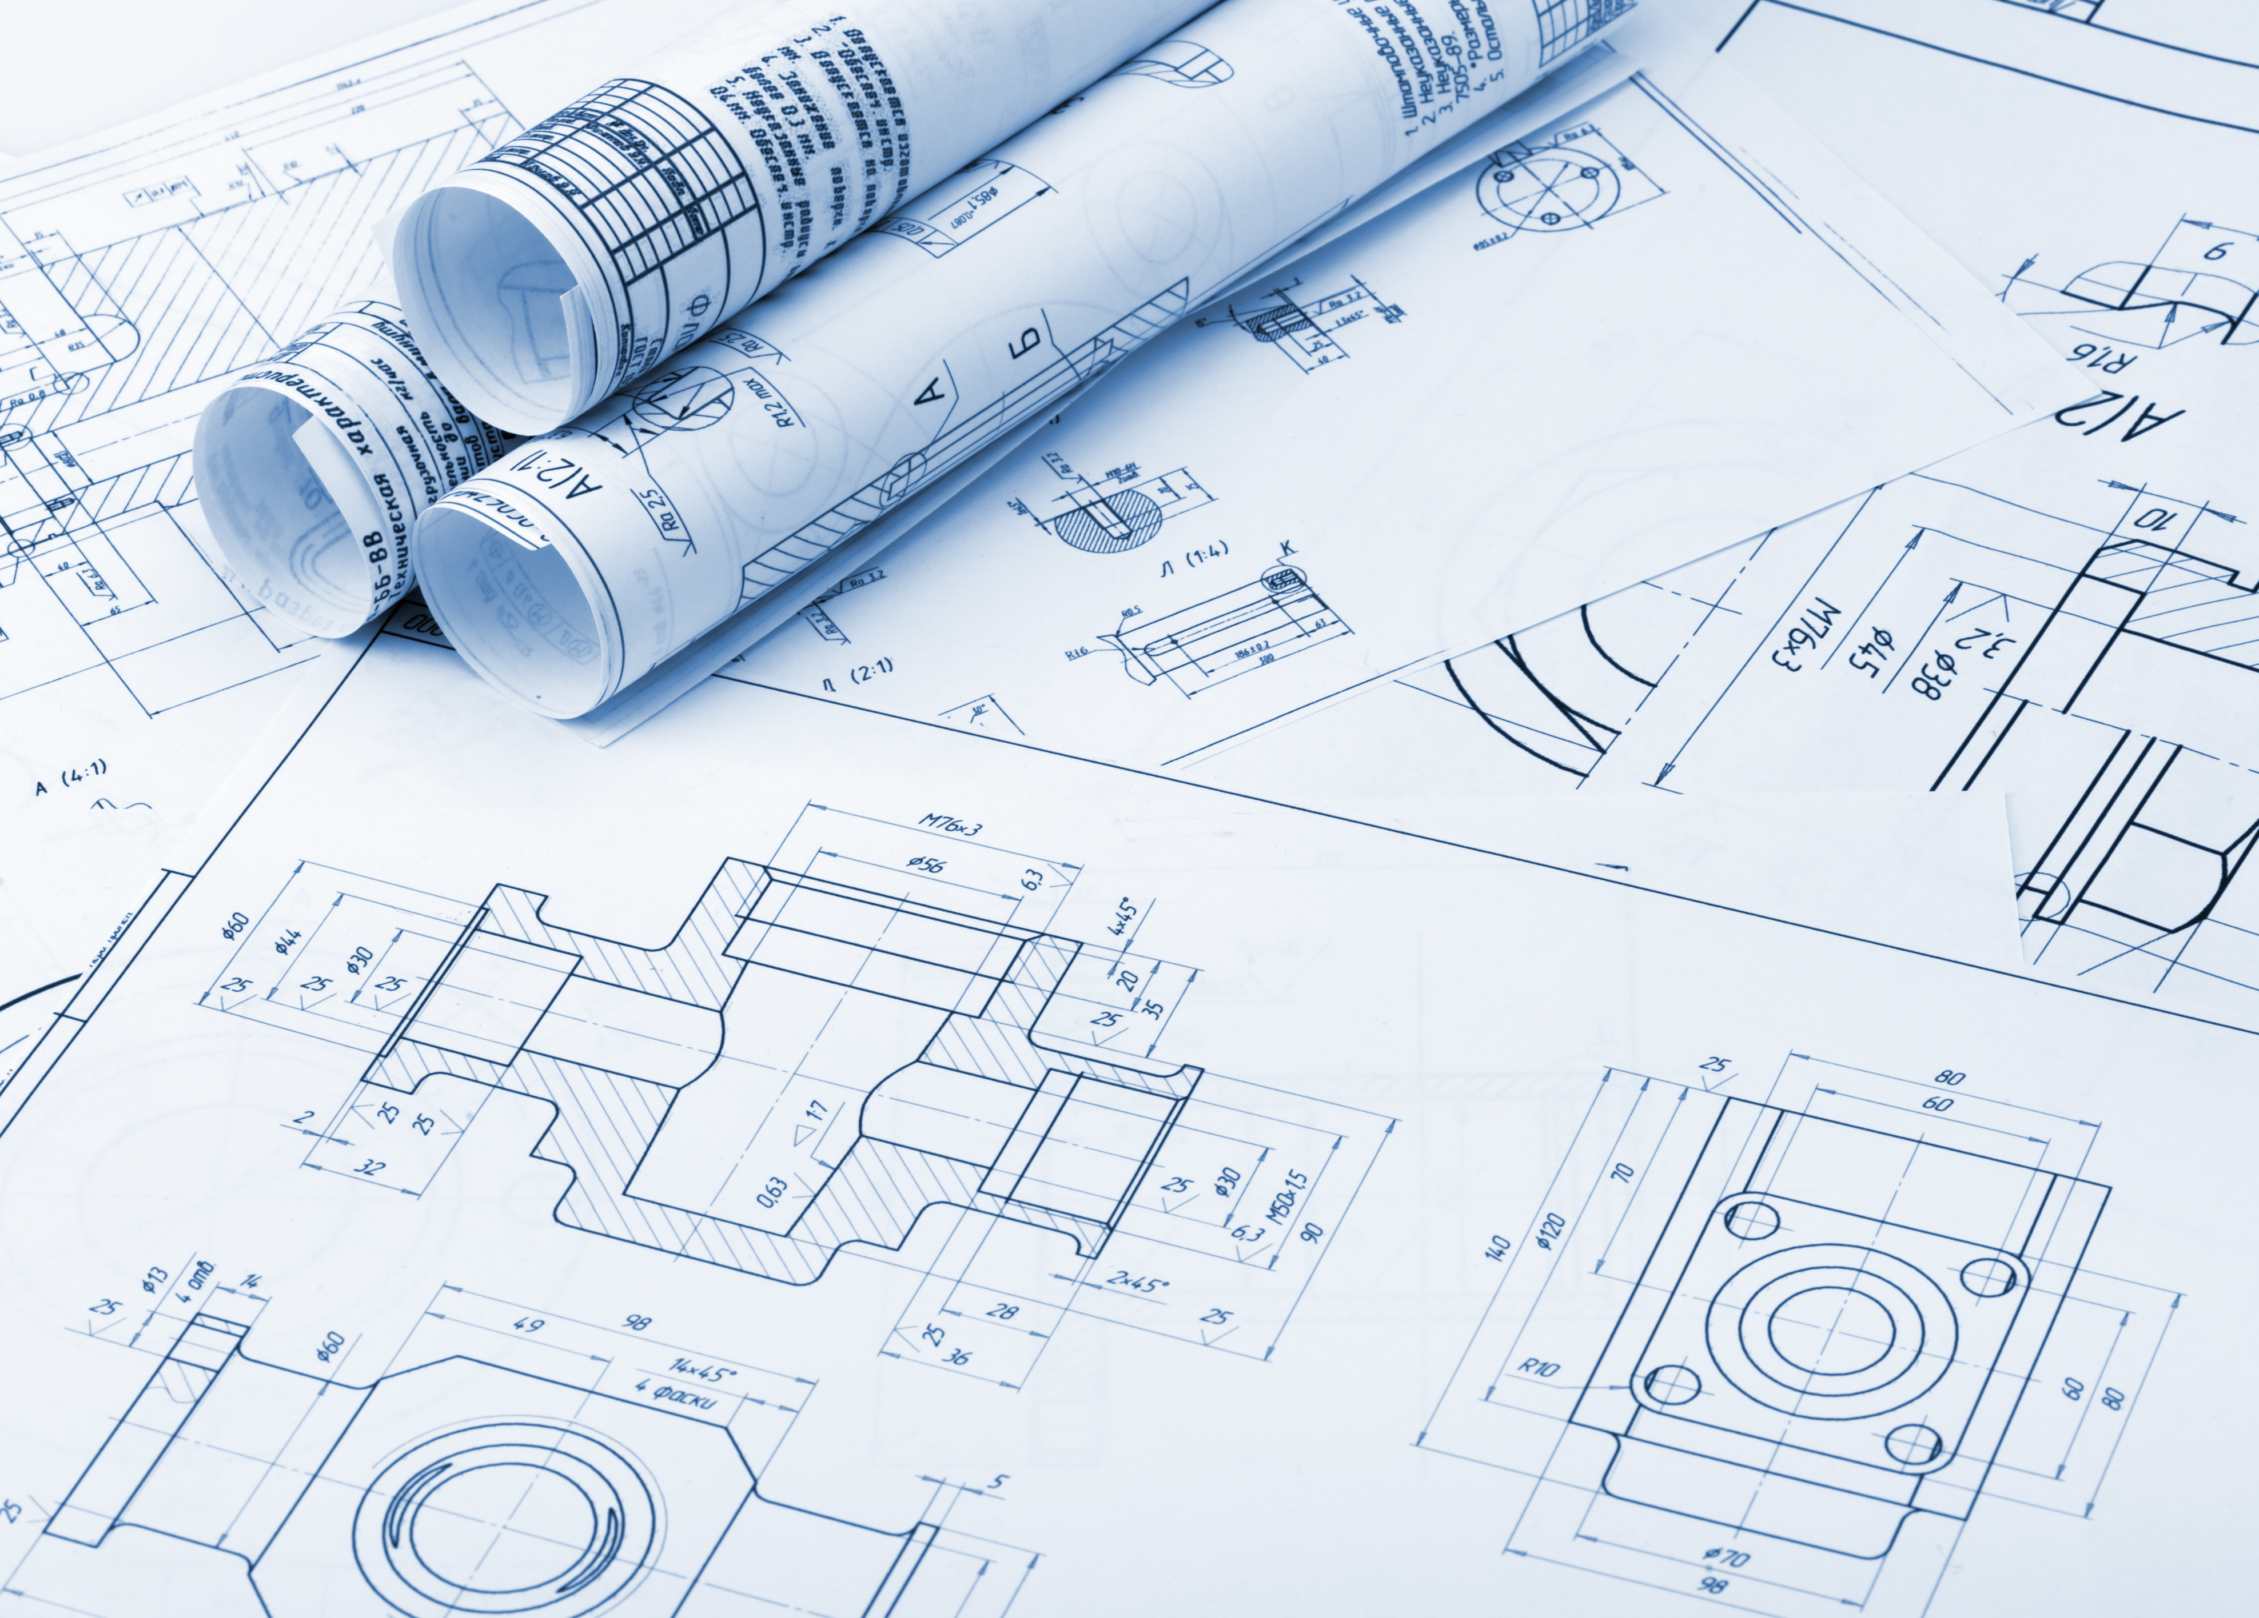
B.A.T.M.A.N.
Organization
Macro Planning
1. Semester
2. Semester
1 Year
Topics
Features and Restrictions
Continuous User Stories
Set up
Research and training
Development: Architecture, Software, Documentation etc.
Groups, IT infrastructure, topics and work mode
Presentation of research results and demonstrators
Final presentation and submission
Input
Output
Consolidated results that have to be presented and will be part of the grading

Slide 12


B.A.T.M.A.N.
Organization
Micro Planning
Events without Supervisors
Daily or Weekly
Work sessions
Other group specific events
Daily or Weekly
Status reports and
Result reports
Product
Backlog
Sprint Planning
Review
Events with Supervisors
Sprint Planning
Review
Every 3 weeks
Instruments
Kanban Board (MS Planner)
Documents for work tracking and e. g. burndown charts
Etc.
Sprint Backlog
Setting up an agile work process will be your task. Based on requirements (e.g. recording of working hours and activities) you can choose the tools yourself. The Scrum Master will be responsible for ensuring that the process is followed.
!

Slide 13
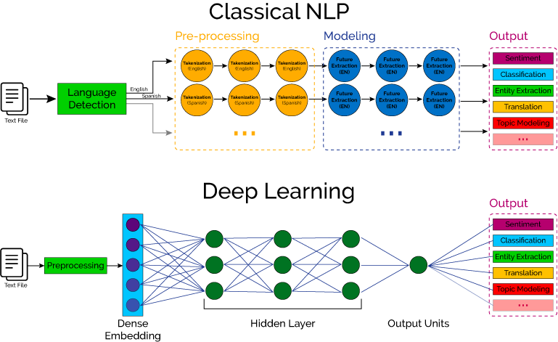
Topics
Group Unity
Group Artificial Intelligence
3D Scenario reference library
3D Scenario viewer
Data Base, Model and Exchange
Concept and Architecture of NLP Pipeline
Automatic 3D scenario generation
3D Environment editor
Training and Inferencing
Optimization and Extension

Slide 14
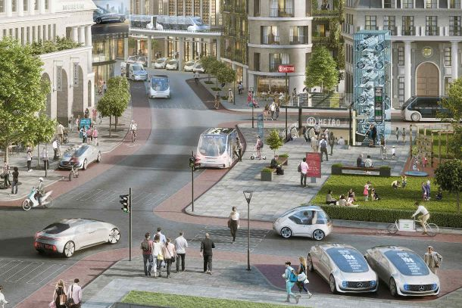
Kick-Off Topic: Unity - 3D Scenario reference library
Group Unity
Tasks
Sketch
Systematic collection of security & safety automotive reference scenarios
Identification of new reference scenarios
Design of reference scenarios in Unity
Build up systematic automotive 3D model library
Technologies
Unity 3D
Online 3D model libraries (Unity Asset Store, Scetchfab, …)
Google: Literature research on reference scenarios

Slide 15

Kick-Off Topic: Unity - 3D Scenario viewer
Group Unity
Tasks
Sketch
Develop intuitive viewer for created 3D scenarios
Load selected scenarios in 3D Engineer
AR/VR - Deployment to Oculus Quest, iOS-Tablet etc.
Technologies
Unity 3D
Visual Studio C#
Google: Literature research

Slide 16
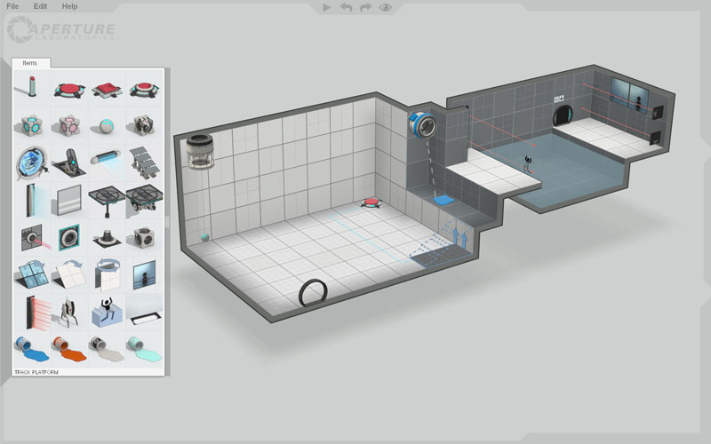
Kick-Off Topic: Unity - 3D environment editor
Group Unity
Tasks
Sketch
Develop intuitive environment editor for creating rooms, factory halls, basically every environment for a technical system
Create reference enviroments
Technologies
Unity 3D
Snap technology
Visual Studio C#
Google: Literature research

Slide 17

Kick-Off Topic: Unity - Automatic 3D scenario generation
Group Unity
Tasks
Sketch
Develop interface from unity to Neo4j
Load scenario description from Neo4j graph database
Build up automatic security & safety scenarios based on created reference scenarios
Technologies
Neo4j graph database
Unity 3D
Visual Studio C#
Google: Literature research on building up 3D reference scenarios

Slide 18
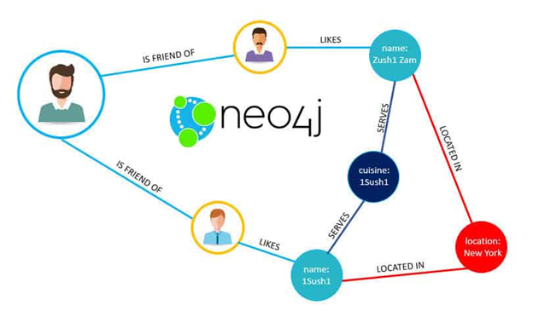
Kick-Off Topic: A.I. – Data Base, Model and Exchange
Group A.I.
Tasks
Sketch
Identification of relevant Data Sources,
Derivation of requirements for data integration and pre-processing
Analysis of existinging and planned target database and datamodel
Implementation of data exchange
Technologies
Neo4j graph database and if necessary cypher (Query language for graphs)
Python
Pycharm or similar
JSON
Google: Literature research on useful information sources (Blogs, News, CVE Databases etc.)
News
IT-Blogs
Security Databases (CVE)
…

Slide 19

Kick-Off Topic: A.I. – Concept and Architecture of NLP Pipeline
Group A.I.
Tasks
Sketch
Analysis of previous results and architecture
Derivation of requirements (to adapt the existing one)
Development concept and architecture for NLP Pipeline
Pre-Processing, Feature extraction etc.
Goal: Identification of potential relevant Hazards and Vulnerabilities from unstructured text files
Proof of Concepts
Technologies
Python
Pycharm or similar
DeepL libraries: PyTorch
NLP-libraries: Google BERT or spaCy
Google: Literature research

Slide 20
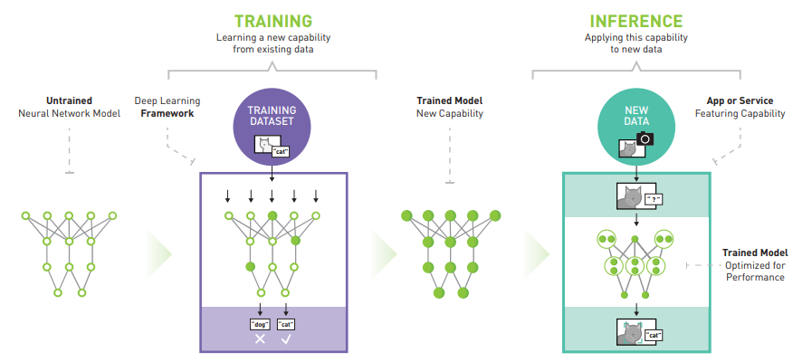
Kick-Off Topic: A.I. – Training and Inferencing
Group A.I.
Tasks
Sketch
Domain Training / Adaption of pre-trained Models like BERT
Implementation of Pipelines for Training and Inferencing
Training the Model (supervision etc.)
Technologies
Python
Pycharm or similar
DeepL libraries: PyTorch
NLP-libraries: Google BERT or spaCy
Google: Literature research

Slide 21

Kick-Off Topic: A.I. – Optimization and Extension
Group A.I.
Tasks
Sketch
Expansion of potential data sources
General optimizations (Performance etc.)
Extension of the extractable aspects (e.g. road situation, weather conditions)
Technologies
Python
Pycharm or similar
DeepL libraries: PyTorch
NLP-libraries: Google BERT or spaCy
Google: Literature research

Slide 22
Next Steps (Organisation)
Until friday (2019/04/30):
Send us your preference for the A.I. or the A.R. (Unity) group (sergej.japs@iem.fraunhofer.de)
Find a date for weekly meetings with supervisors (regular meetings from next slide)
Watch tutorials (maybe there will be a surprise quiz ;-) ):
https://www.youtube.com/watch?v=CH2seLS5Wb0 (Microsoft Teams)
https://www.youtube.com/watch?v=p82hS0K32fA (Microsoft Planner)
https://www.youtube.com/watch?v=gEARZ20M-Zc (Unity)
https://www.youtube.com/watch?v=8S3qHHUKqYk (NLP)
https://www.youtube.com/watch?v=8dGdIcyDk1w (Scrum)
Of course further research or video tutorials of the topics (Unity, NLP, Scrum) are recommended
Register for the examination in PAUL

Slide 23
Next Steps (Organisation)
Regular meetings
Planning and Review (first every week and later every 3 weeks) - options:
A) Each Friday: 11 am to 1 pm
B) Each Tuesday: 1 pm to 3 pm
C) Each Wednesday: 1 pm to 3 pm
Additional meetings are of course possible if necessary
Next meeting for next steps and further informations – options:
A) 04.05.2020, Monday, 11 am to 1 pm
B) 05.05.2020, Tuesday, 2 pm to 4 pm

Slide 24
Next Steps (Organisation)
Weekly meeting with the supervisors (mandatory)
Organize yourselves
Plan the weekly meeting (i.e. agenda)
Distribute the work
Important: find a common day where all of your group can work together
Microsoft Teams:
Team communication
Sprint planning / backlog
Sharepoint integration (documents)
GIT Server: tbd
Work regularly (min 13h/week)
Track your time
Plan your holidays

